Slide 1
Doing Data Science
Unit 4 Gathering Data for Analysis
Faizan Javed
Data Science @ SMU

Slide 2
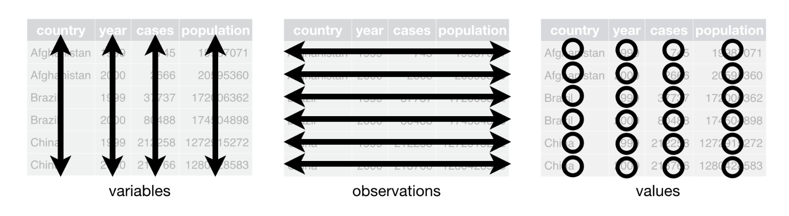
Tidy Data
Rules for a tidy dataset:
Each variable must have its own column.
Each observation must have its own row.
Each value must have its own cell.
Advantages of a tidy data representation?

Slide 3
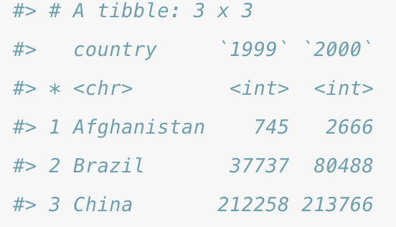
Gathering
E.g., the column names 1999 and 2000 represent values of the year variable, and each row represents two observations, not one.

Slide 4
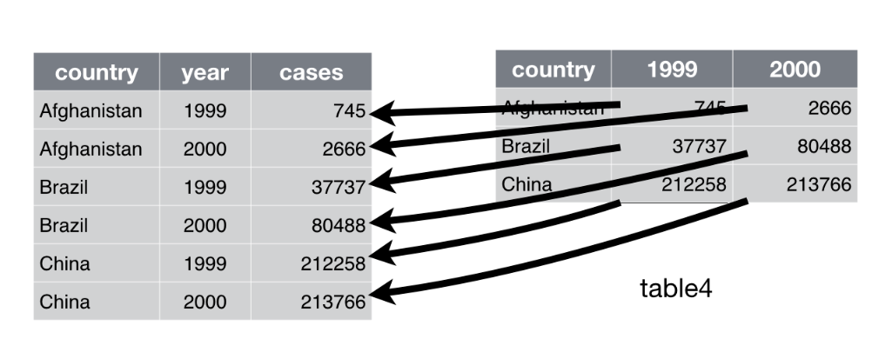
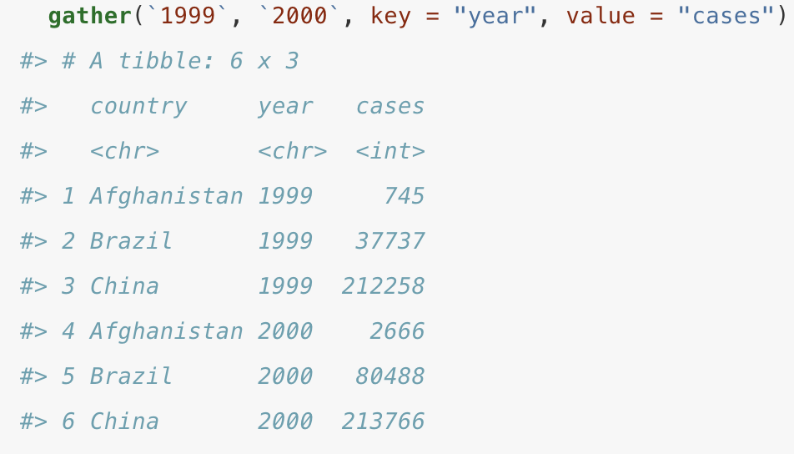
Gathering

Slide 5
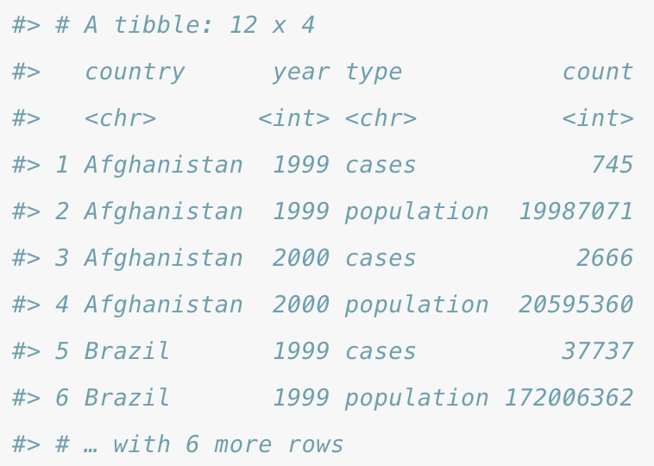
Spreading
E.g., an observation is a country in an year, but each observation is spread across two rows

Slide 6
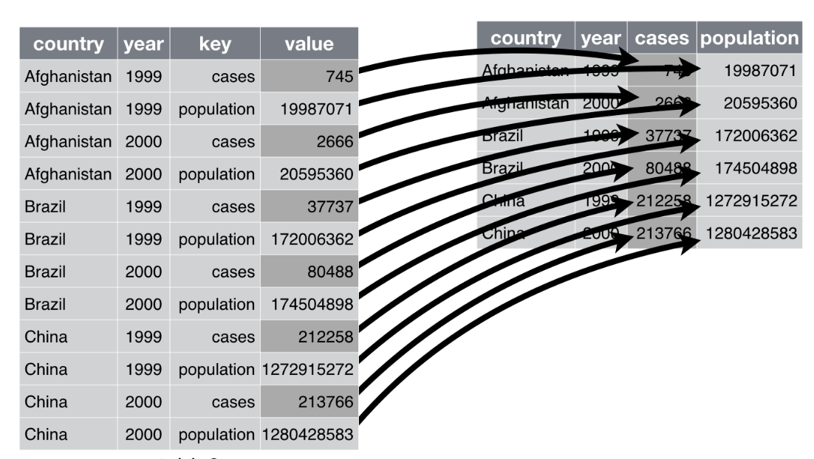
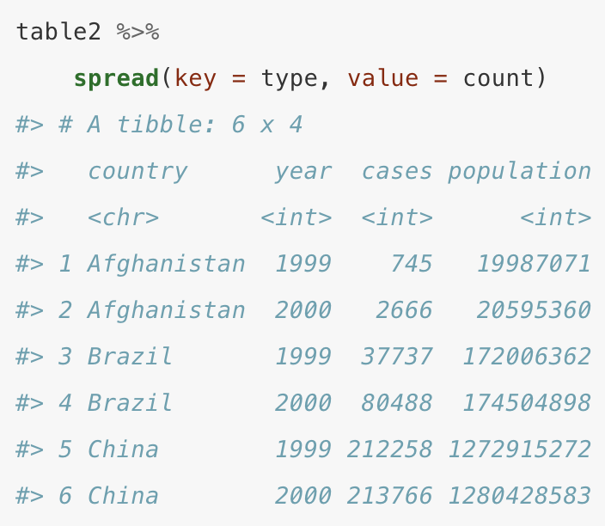
Spreading

Slide 7
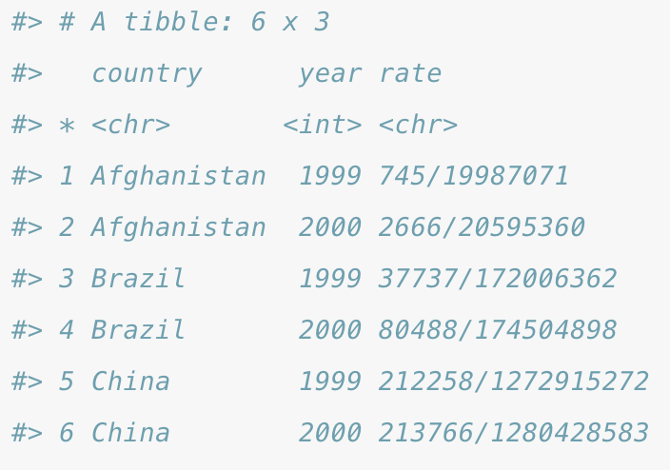
Separate
Pulls apart one column into multiple columns, by splitting wherever a separator character appears, e.g., rate has both cases and population variables

Slide 8
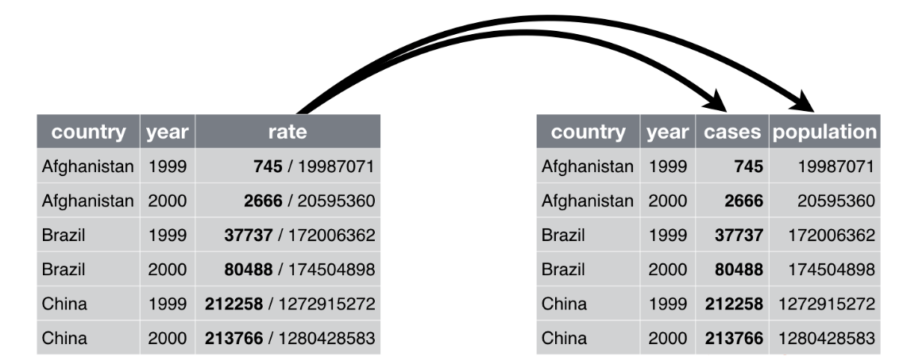
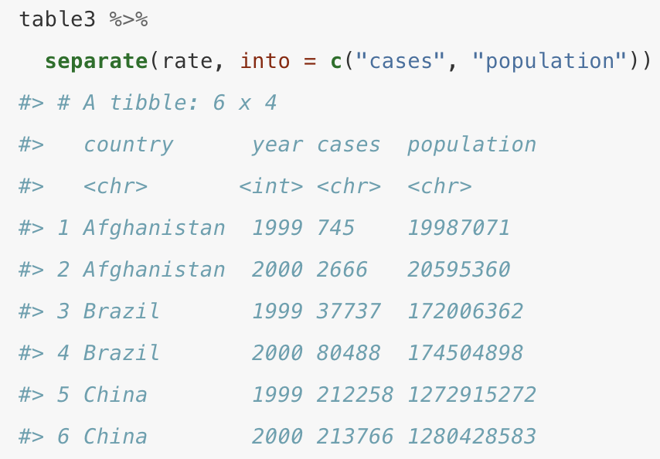
Separate

Slide 9
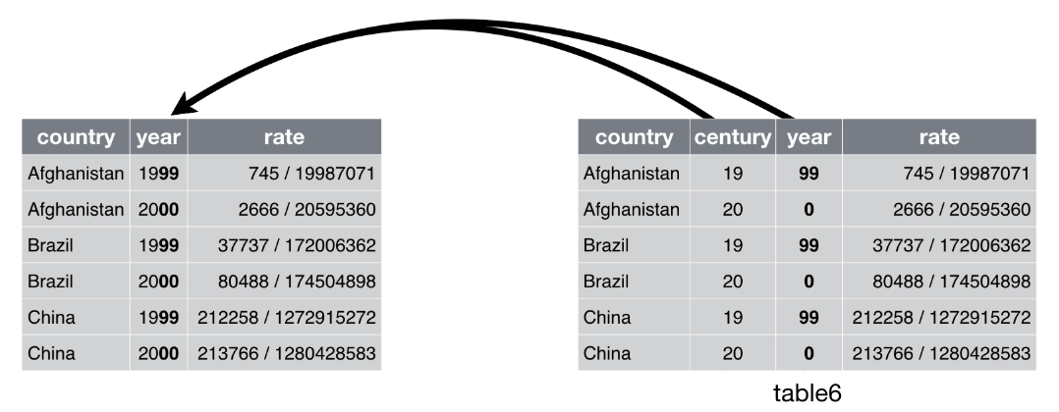
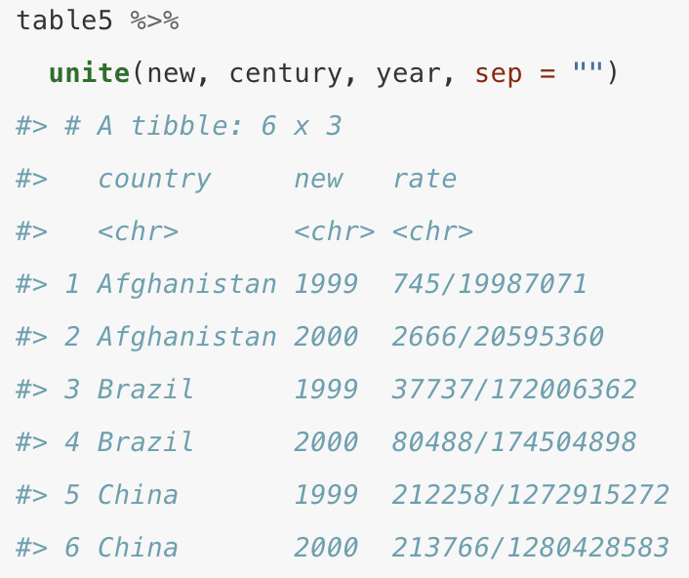
Unite
Combines multiple columns into a single column (not as frequently used as other functions).

Slide 10
API (Application Programming Interface)
Application: a software program designed for the end user (usually solves a specific problem).
E.g., MS Excel, Mint.com, Facebook app, et al
Programming: techniques for communicating with the application to accomplish certain tasks.
Interface: User Interface (UI) - how to interact with the application. (inputs, outputs, data).

Slide 11
R Data APIs and feeds
Openair : air quality data
Quantmod : finance data
Treebase : phylogenetic data from TreeBASE
rOpenSci : scientifica data from web-based sources
...each of these packages has its own syntax! (good or bad?)

Slide 12
Web APIs
Use a set of standard protocols (SOAP or REST)
GET – send a query with optionally a set of parameters to an endpoint and get a response.
POST – sends a data payload to an endpoint to be processed with a success message as a response.
GET and POST are part of the REST protocol
Use the POSTMAN app to test/debug API calls :https://www.getpostman.com/

Slide 13
E.g., Open Skills API http://dataatwork.org/data/
https://github.com/workforce-data-initiative/skills-api/wiki/API-Overview#introduction
http://api.dataatwork.org/v1/jobs/{id}/related_skills
Skills Associated with a Job
Retrieves a collection of skills associated with a specified job.
{Id} = af2e31c2c64ae223b06eb7f0cbf59a98
Use: web browser URL, or http://www.apirequest.io/

Slide 14
Response of the previous call:
{ "job_uuid": "af2e31c2c64ae223b06eb7f0cbf59a98", "job_title": "3D Animator", "normalized_job_title": "3d animator", "skills": [ { "skill_uuid": "c6578b03a984971e23ca21daed316dd0", "skill_name": "communications and media", "description": "knowledge of media production, communication, and dissemination techniques and methods. this includes alternative ways to inform and entertain via written, oral, and visual media.", "normalized_skill_name": "communications and media", "importance": 4.49, "level": 5.36 }, { "skill_uuid": "31c13f47ad87dd7baa2d558a91e0fbb9", "skill_name": "design", "description": "knowledge of design techniques, tools, and principles involved in production of precision technical plans, blueprints, drawings, and models.", "normalized_skill_name": "design", "importance": 4.46, "level": 4.93
….

Slide 15
In R: use the httr package to create API calls https://blog.rstudio.com/2014/03/21/httr-0-3/
# install.packages("httr") library(httr)
# Find the most recent R questions on stackoverflow r <- GET( "http://api.stackexchange.com", path = "questions", query = list( site = "stackoverflow.com", tagged = "r" ) )
stop_for_status(r) # Check the request succeeded questions <- content(r) # Automatically parse the json output
questions$items[[1]]$title #> [1] "Remove NAs from data frame without deleting entire rows/columns"

Slide 16
XML and JSON
XML: Extensible Markup Language
Markup: “Describing data”, what does the data represent
Used for interchange of data over the internet → a standardized format
Xpath: XML Path Language
Used to navigate, select, transform elements in an XML document
XML vs HTML - are they similar? What are the differences?

Slide 17
“nodename” selects all nodes with the name “nodename”
/ : selects from root node
// : selects nodes in document from the current node that match the selection
@ selects attributes
Xpath:
bookstore #selects all nodes with name “bookstore
/bookstore #selects the root element bookstore
/bookstore/book[1] #selects the first book element
//title[@lang] #selects all title elements that have an attribute named lang
<?xml version="1.0" encoding="UTF-8"?>
<bookstore>
<book>
<title lang="en">Harry Potter</title>
<author>J K. Rowling</author>
<year>2005</year>
<price>29.99</price>
</book>
</bookstore>
-----------------------
Nodes, child nodes, sibling nodes

Slide 18
In R: the xml2 library
library(xml2) x <- read_xml("
<foo> <bar>text <baz id = 'a' /></bar> <bar>2</bar> <baz id = 'b' /> </foo>") xml_name(x) #> [1] "foo" xml_children(x) #> {xml_nodeset (3)} #> [1] <bar>text <baz id="a"/></bar> #> [2] <bar>2</bar> #> [3] <baz id="b"/>
# Find all baz nodes anywhere in the document baz <- xml_find_all(x, ".//baz")
baz #> {xml_nodeset (2)} #> [1] <baz id="a"/> #> [2] <baz id="b"/>
xml_path(baz) #> [1] "/foo/bar[1]/baz" "/foo/baz"
xml_attr(baz, "id") #> [1] "a" "b"

Slide 19
JSON: JavaScript Object Notation
Derived from javascript, a popular language for web programming.
“Human readable” text to transmit data objects
In R: use jsonlite → very powerful bidirectional mapping between JSON data and R data types

Slide 20
Example 1: XML vs JSON
<?xml version="1.0" encoding="UTF-8"?>
<bookstore>
<book>
<title lang="en">Harry Potter</title>
<author>J K. Rowling</author>
<year>2005</year>
<price>29.99</price>
</book>
</bookstore>
{
"book": {
"title": {
"@lang": "en",
"#text": "Harry Potter"
},
"author": "J K. Rowling",
"year": "2005",
"price": "29.99"
}
}

Slide 21
Another example: which one do you prefer?
<employees> <employee> <name>Bob</name> <email>robertD@gmail.com</email> </employee> <employee> <name>Jane</name> <email>jane101@yahoo.com</email> </employee> <employee> <name>Harry</name> <email>harry123@gmail.com</email> </employee> </employees>
{"employees":[
{"name":"Bob", "email":"robertD@gmail.com"},
{"name":"Jane", "email":"jane101@gmail.com"},
{"name":"Harry", "email":"harry123@gmail.com"}
]}

Slide 22
JSON (“fat-free alternative to XML”):
More “human readable”, less verbose
Best for sharing “traditional data”. Data is stored in arrays and records while XML stores data in trees
Very easy to transfer data from JSON file into many languages.
XML:
More extensible (allows photos, audio, video and other files)
Better for sharing documents (can include data types like images, charts, etc)

Slide 23
What did you learn today?
Questions?

